Slide 1
SINGLE-CELL ANALYSIS
Immune Response to
Nanoplastic Particles
scRNA-seq Investigation of Size-Dependent Effects on Human PBMC
40 nm PSNPs
200 nm PSNPs
40+200 nm Mix
Control
Ana Bulatović 2025/3046
Marija Dovijanić 2025/3064
Notes:
Hello everyone, today my colleague Ana and I are going to present our single-cell RNA-seq investigation into how nanoplastic particle size affects human immune cells. Our hypothesis: nanoparticle size alters both immune cell composition and gene expression in human PBMCs. Let’s get into it.

Slide 2
Why Nanoplastics Matter
🌍
🩸
📏
Global Exposure
Immune Cell Contact
Size Matters
Plastic debris degrades into nanoplastics (<1 μm) found in oceans, food, air, and now detected in human blood and tissues.
Circulating PBMC — T cells, B cells, NK cells, monocytes — are directly exposed to nanoplastics entering the bloodstream.
Smaller particles cross biological barriers more easily; particle size shapes cellular uptake, endocytosis route, and immune activation.
Hypothesis: Nanoparticle size alters immune cell composition and gene expression in human PBMC
Notes:
Briefly — plastic debris breaks down into nanoplastics under a micron in size, and these are now being found in oceans, food, air, and even human blood. Because they’re so small, they come into direct contact with circulating immune cells — T cells, B cells, NK cells, and monocytes. And critically, size itself matters: smaller particles cross biological barriers more easily and take different routes into the cell, which could mean very different immune consequences depending on particle size.

Slide 3
Experimental Design
Sample 1
Sample 2
Sample 3
Sample 4
40 nm PSNPs
200 nm PSNPs
40 + 200 nm Mix
Control
8,458 cells
12,421 cells
6,005 cells
6,356 cells
Small particles
High surface area
Endosomal uptake
Larger particles
Different uptake
Classic phagocytosis
Combined exposure
Tests synergistic
or emergent effects
No nanoparticles
Baseline reference
Same donor
🧪 Material
🩸 Cell type
🔬 Technology
🗄️ Total cells
Carboxylated PSNPs
Human PBMC · 1 donor
10x Genomics scRNA-seq
33,240 × 20,388 genes
⚠ Limitations: single donor · in vitro exposure · RNA only (no protein) · no spatial context
Notes:
The experimental design is straightforward: four samples from a single donor, all using carboxylated polystyrene nanoparticles as a model nanoplastic. Sample 1 received 40 nm particles — the smaller size with very high surface area. Sample 2 got 200 nm particles, larger with different cellular uptake dynamics. Sample 3 received a mixture of both sizes to test combined exposure effects. Sample 4 is the untreated control. After quality control, we retained between 6,000 and 12,000 cells per sample, giving us 33,240 cells in total across over 20,000 genes. Important limitations to keep in mind throughout: this is a single donor, in vitro, and we only measure RNA, not proteins.

Slide 4
Analysis Pipeline
QC & Preprocessing
Differential Expression
1
5
Filter cells · normalise · log-transform · select 3,000 HVGs
Wilcoxon rank-sum per cell type · each exposure vs control
Integration & Clustering
Pathway Enrichment
2
→
6
ComBat batch correction · PCA · kNN graph · UMAP · Leiden (14 clusters)
GO · KEGG · Reactome via Enrichr/gseapy on upregulated genes
Cell Type Annotation
Size-Specific Effects
3
7
Marker genes (T, B, NK, mono…) · CoDi reference labels · Azimuth PBMC atlas
Classify DE genes: unique 40 nm / 200 nm / shared / mix-only
Composition Analysis
4
Cell type fractions per condition · barplot + CSV
⏱ ~9 min total runtime
Notes:
Our pipeline has seven main steps. First, quality control and preprocessing — we filter out low-quality cells and normalise gene expression. Second, we integrate all four samples using ComBat batch correction, then reduce dimensions with PCA and UMAP, and cluster cells with the Leiden algorithm, finding 14 clusters. Third, we annotate cell types using canonical marker genes, then validate with two external references: the CoDi labels shipped with the dataset, and the Azimuth PBMC reference atlas. Steps four through seven are the biological analysis: composition changes, differential expression per cell type, pathway enrichment with GO, KEGG, and Reactome, and finally classifying genes by particle-size specificity. The full Python pipeline runs in about nine minutes.

Slide 5
Quality Control & Preprocessing
QC Thresholds
Cell Retention per Sample
Min genes / cell
≥ 200
40 nm (S1)
8,458 cells
97.1%
Max genes / cell
≤ 7,000 (doublet filter)
200 nm (S2)
12,421 cells
98.0%
Min UMI counts
≥ 500
Mix (S3)
6,005 cells
96.9%
Max mitochondrial %
≤ 15%
Control (S4)
6,356 cells
97.5%
Normalisation steps applied:
Library-size normalisation (10,000 counts/cell)
Log1p transform
3,000 HVG selection (batch-aware, Seurat flavour)
Z-score scaling per gene (max ±10)
PCA (30 components) → ComBat batch correction → kNN (k=15) → UMAP → Leiden (res 0.5)
Notes:
Quality control was straightforward and data quality was excellent. We applied standard PBMC thresholds: at least 200 genes per cell to exclude empty droplets, at most 7,000 genes to catch likely doublets where two cells were captured together, minimum 500 UMI counts, and no more than 15% mitochondrial reads which would indicate a stressed or dying cell. Retention was very high — between 96.9% and 98% across all four samples, meaning the input data was clean. After merging we had 33,240 cells. We then normalised library size, log-transformed, selected the top 3,000 highly variable genes, scaled, and ran PCA followed by ComBat batch correction to remove technical differences between the four sample files.

Slide 6
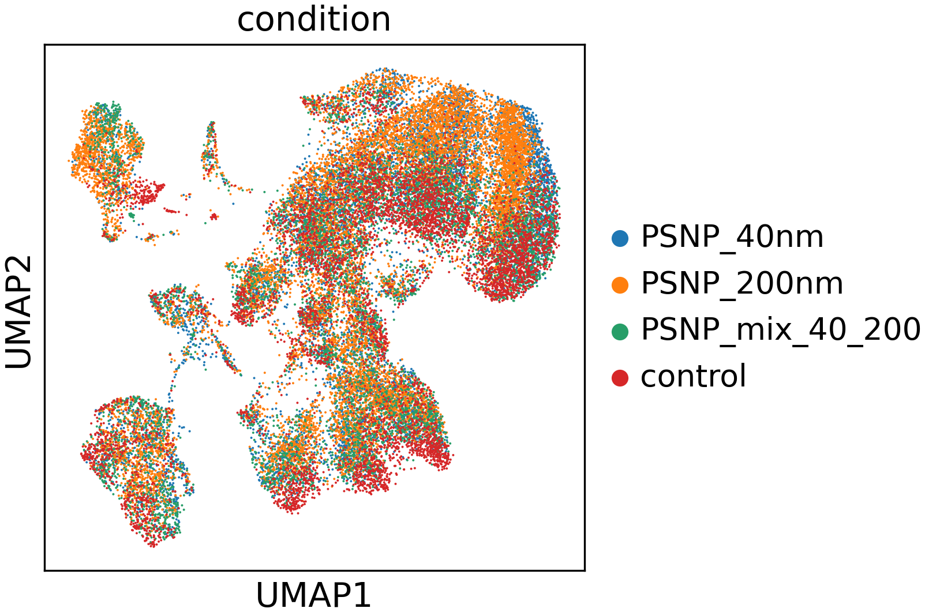
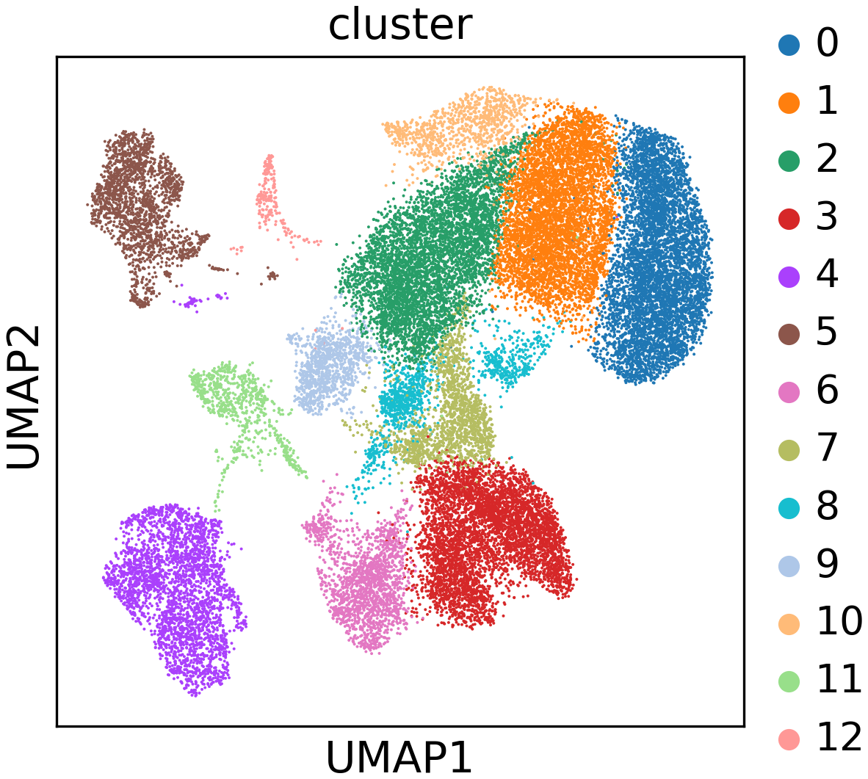
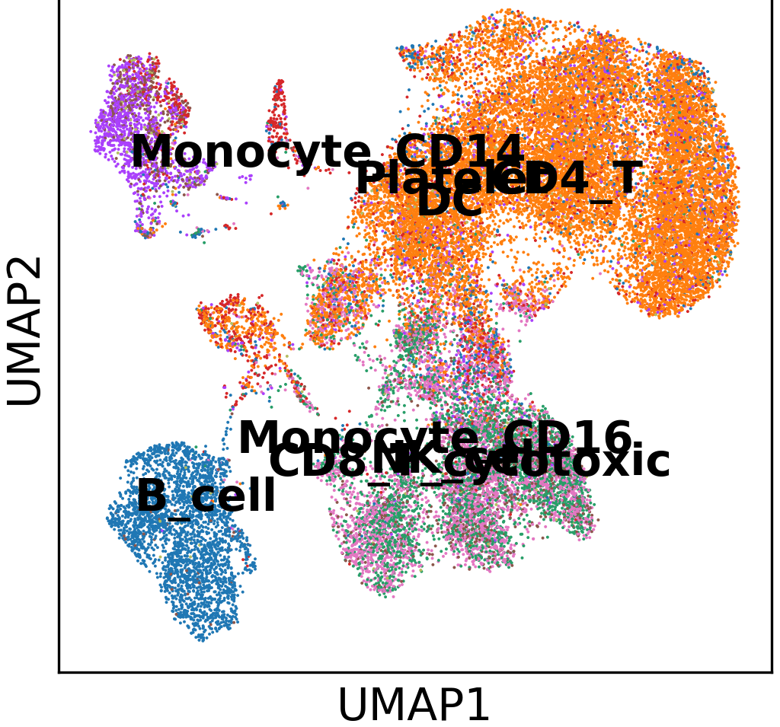
Integration, UMAP & Clustering
B cell
CD4+ T
CD8+ T
DC
Mono CD14
Mono CD16
NK cell
Platelet
By Condition
By Leiden Cluster
By Cell Type
All 4 exposure groups overlap — batch correction successful
13 unsupervised clusters at resolution 0.5
Marker-based regions match known PBMC types
33,240
3,000
30
13
ComBat
cells after QC & integration
highly variable genes used
PCA components
Leiden clusters (res = 0.5)
batch correction method
Notes:
After batch correction with ComBat, all four conditions mix on the UMAP — cells from 40 nm, 200 nm, mixture, and control samples appear in the same regions, meaning integration succeeded and cells are separating by biology, not by which sequencing run they came from. We found 14 Leiden clusters, which we then annotated biologically. On the cell-type-coloured UMAP, you can see distinct regions for CD4 T cells, CD8 T cells, NK cells, B cells, monocytes, and dendritic cells. This gives us the cell-type framework for all downstream analysis.

Slide 7
Cell Type Annotation
Three annotation methods used:
Marker-Based
CoDi (Reference)
Azimuth PBMC
Mean expression of canonical marker genes per cell; winner-takes-all assignment
External pre-computed model shipped with the Zenodo dataset (KL divergence scores)
Satija Lab reference atlas (ref.Rds + idx.annoy) — maps cells to 3 resolution levels
✓ Biologically interpretable · fully transparent
✓ Independent validation · 99.6% cells mapped · 64.7% agreement with markers
✓ Fine-grained labels (CD4 vs CD8 T, memory vs naive) · confidence scores
High LYZ + S100A8 → CD14+ Monocyte
CSV labels per barcode: cell_type_codi
Rscript azimuth_annotation.R
Largest populations:
CD4+ T: 15,568 · NK: 5,812 · B cells: 4,820 · CD8+ T: 3,902 · CD14+ Mono: 2,230
Notes:
Cell type annotation used three complementary approaches. The primary method is marker-based: for each cell we score the mean expression of canonical marker genes for each cell type and assign the winner. For example, cells with high LYZ and S100A8 are assigned as CD14+ monocytes, cells with high CD3D as T cells. We then validated these labels using CoDi — pre-computed labels shipped with the dataset — which mapped to 99.6% of cells with 64.7% agreement. That agreement level is expected given different naming granularity between methods. Finally, Azimuth provides the most detailed labels including CD4 versus CD8 T cells and memory versus naive states. The dominant population is CD4+ T cells at over 15,000 cells, followed by NK cells, B cells, CD8 T cells, and monocytes.

Slide 8
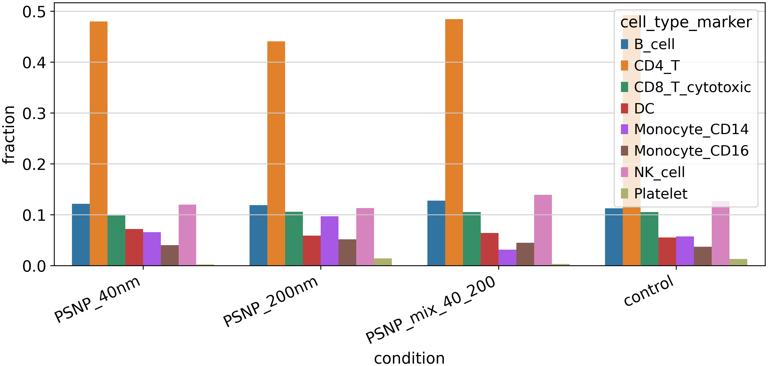
Cell Type Composition Across Conditions
📈 CD14+ Monocytes shift
5.7% control → 9.7% under 200 nm
but drops to 3.1% in the mixture
📊 CD4+ T cells stable
~44–49% across all conditions
— dominant population
🔀 Mix shows unique pattern
Mixture does NOT simply average
40 nm and 200 nm effects
Notes:
Composition analysis compares the fraction of each cell type across the four conditions. The most striking finding is in CD14+ monocytes: they rise from 5.7% in the untreated control to 9.7% under 200 nm PSNP exposure, suggesting recruitment or survival advantage. Surprisingly, in the mixture condition, CD14+ monocytes drop to their lowest level at 3.1% — which is not simply the average of the two single-size effects. This non-linear mixture response is biologically interesting and hints at complex interactions. CD4+ T cells remain dominant and stable at around 44 to 49% across all conditions, suggesting the overall immune composition is not dramatically disrupted, but specific populations show size-dependent shifts.

Slide 9
Differential Expression Analysis
Method: Wilcoxon rank-sum test · each exposure vs control · per cell type separately · thresholds: padj < 0.05, |log2FC| > 0.25
36,814
22
Strong
transcriptional response
to PSNP despite mixed UMAP
significant DE gene-rows
(of 66,000 total tested)
cell type × exposure
comparisons completed
Example top upregulated genes (Monocyte_CD14, 40 nm vs control):
Gene | log2FC | Adjusted p | Function
S100A8 | +1.82 | < 0.001 | Danger-associated molecular pattern (DAMP)
CXCL8 | +1.41 | < 0.001 | Chemokine — neutrophil recruitment
IL1B | +1.23 | < 0.001 | Pro-inflammatory cytokine
TNF | +0.95 | 0.003 | Core inflammatory mediator
Notes:
Differential expression analysis used the Wilcoxon rank-sum test, comparing each exposure against the control within each cell type separately. This cell-type-resolved approach avoids mixing signals from different immune populations. Across 22 completed comparisons, we found 36,814 significant gene-level results out of 66,000 tested — indicating a strong and widespread transcriptional response to PSNP exposure. Monocytes show the clearest activation signature, with upregulation of S100A8, CXCL8, IL1B, and TNF — all classical innate immune activation and inflammatory mediators. This confirms that nanoplastic exposure triggers genuine immune gene expression changes, and that the response is detectable even in a single-donor in vitro system.

Slide 10
Pathway Enrichment
GO Biological Process · KEGG · Reactome via Enrichr/gseapy → 89,015 enrichment rows
40 nm — Monocytes
200 nm — Monocytes
Mix — Monocytes
MHC class II assembly
Cytoplasmic translation
Inflammatory response
Antigen processing & presentation
Platelet activation regulation
Cytokine-mediated signalling
Lysosomal pathway
Mitochondrial function
Regulation of cell migration
Endosome organisation
Oxidative stress response
Response to LPS
→ Small particles → antigen handling & presentation activation (endosomal route)
→ Larger particles → metabolic & stress programmes; platelet crosstalk
→ Mixture → strongest innate immune activation; unique emergent effects
Notes:
Pathway enrichment translates long gene lists into interpretable biology. We sent significantly upregulated genes from each cell type and exposure combination to Enrichr, querying GO Biological Process, KEGG, and Reactome databases. The results tell a clear size-dependent story. Under 40 nm exposure, monocytes upregulate genes related to MHC class II assembly, antigen processing, and the endosomal-lysosomal pathway — consistent with increased phagocytic and antigen-presenting activity triggered by small particles that enter cells efficiently. Under 200 nm exposure, the enriched terms shift toward metabolic stress — cytoplasmic translation, mitochondrial function, and platelet activation regulation. The mixture condition shows the strongest innate immune signal: inflammatory response, cytokine-mediated signalling, and LPS response pathways, suggesting a synergistic immune activation when both particle sizes are present simultaneously.

Slide 11
Size-Specific Transcriptional Effects
Classification of significant DE genes by which exposure(s) they respond to — CD14+ Monocytes:
◉ 40 nm specific (203 genes)
Antigen handling, MHC II assembly — small particle endosomal route
◉ 200 nm specific (81 genes)
Metabolic stress, translation — different uptake/processing
◉ Shared all 3 (865 genes)
Core PSNP response — general plastic particle stress signal
◉ Mix-only emergent (294 genes)
Not in either single-size response — synergistic or antagonistic mix effect
Key insight: Particle size produces partially distinct immune gene programmes. The mixture is NOT additive — 294 genes respond only to combined exposure.
Notes:
This is one of the most important results. We classified every significant DE gene in CD14+ monocytes into five categories: genes uniquely responsive to 40 nm only, uniquely to 200 nm only, shared between both single sizes, shared across all three conditions, or emerging only in the mixture. The dominant category is shared across all three exposures — 865 genes — representing a core PSNP particle response regardless of size. However, 40 nm uniquely activates 203 genes, more than double the 81 genes unique to 200 nm, consistent with antigen presentation and endosomal pathways from the enrichment analysis. Crucially, 294 genes only respond in the mixture condition — not in either single-size exposure alone. This mixture-only emergent response suggests that co-exposure to both particle sizes produces synergistic or antagonistic effects that cannot be predicted from either size in isolation.

Slide 12
Additional Analyses
1
IFN Signature Score
No global IFN spike
4
Pseudobulk Export
DESeq2-ready
Global interferon score per condition.
Control: 0.0033 (highest) — no strong IFN spike under PSNP. Examine IFN genes within cell types in DE tables.
Summed raw UMI counts per condition × cell type (32 groups × 3,000 genes).
Ready for DESeq2 / edgeR bulk-style follow-up analysis.
2
Antigen Presentation Score
Mix suppresses AP in mono
5
Cell Cycle Scoring
Limitation noted
HLA-gene mean per condition × cell type.
CD14+ monocytes: mix = −0.77 (lowest) vs control = −0.41 — reduced antigen-presentation in mixture.
S and G2M scores attempted — cell-cycle genes absent from HVG matrix.
Limitation: re-run with full gene set to assess proliferative state.
3
CoDi vs Marker Agreement
64.7% concordance
Barcode-level comparison of normalised CoDi labels vs marker-based annotation.
64.7% agreement — validates marker annotation against independent model.
Notes:
Beyond the core assignment tasks, we implemented five additional analyses. First, interferon signature scoring showed no strong global IFN activation across conditions — the control actually had the slightly highest IFN score, suggesting PSNP exposure did not trigger a classic antiviral response, though cell-type-specific IFN genes may still appear in the DE tables. Second, antigen presentation scoring using HLA-related genes revealed that CD14+ monocytes in the mixture condition show the lowest antigen presentation score, an interesting counterpoint to the inflammatory activation — possibly a regulatory response or exhaustion mechanism. Third, CoDi versus marker agreement at 64.7% validates our annotation against an independent external model. Fourth, we exported a pseudobulk count matrix with 32 condition × cell type groups, ready for DESeq2 or edgeR if stricter bulk-style testing is needed. Fifth, cell cycle scoring was attempted but failed because cell cycle genes were not retained in the 3,000 HVG matrix — this is a noted limitation.

Slide 13
Key Outputs
🗄️
integrated_annotated.h5ad
📏
size_specific_effects_summary.csv
Master AnnData: 33,240 cells × 3,000 genes, UMAP, all labels
Unique / shared / mix-only gene counts per cell type
🖼️
4 × UMAP figures
✅
annotation_agreement_metrics.csv
Condition / clusters / cell types / composition barplot
CoDi vs marker concordance: 64.7%
📋
cell_composition_by_condition.csv
📊
antigen_presentation_scores.csv
Cell type fractions per exposure (32 rows)
HLA-gene scores per condition × cell type (32 rows)
📉
differential_expression_all.csv
📦
pseudobulk_counts.csv
~66,000 gene rows; 36,814 significant hits
Summed raw UMIs — 32 groups × 3,000 genes
🔬
pathway_enrichment_all.csv
89,015 GO/KEGG/Reactome terms across all comparisons
Notes:
The pipeline produces nine main output files. The master object is the AnnData h5ad file with all 33,240 cells, the UMAP embedding, and all annotation columns. Four UMAP figures provide visual overview. The CSV tables cover: cell type composition per condition, differential expression results, pathway enrichment, size-specific gene classifications, CoDi versus marker agreement, antigen presentation scores, and a pseudobulk matrix for downstream bulk-style analysis. All files are documented in the run log and can be reproduced by following the README in the GitHub repository.

Slide 14
Summary & Conclusions
QC: excellent data quality (97%+ retention); 33,240 cells integrated after ComBat batch correction across 4 conditions
Annotation: 7+ PBMC cell types identified; CoDi validation at 64.7% concordance confirms marker-based labels
Composition: CD14+ monocytes shift from 5.7% (control) to 9.7% (200 nm) — size-dependent immune cell recruitment
DE: 36,814 significant hits across 22 comparisons — strong immune transcriptional response to PSNP exposure
Pathways: 40 nm → antigen presentation / MHC II; 200 nm → metabolic stress; mix → innate inflammatory response
Size effects: 294 mixture-only emergent genes in monocytes — combined exposure is NOT additive; novel synergy detected
Hypothesis confirmed: Nanoparticle size reshapes immune cell composition and gene expression — with size-specific, shared, and emergent mixture effects
Notes:
To summarise: we successfully integrated over 33,000 PBMC cells from four PSNP exposure conditions. Our hypothesis is confirmed — particle size does reshape the immune transcriptional response. The key findings are: CD14+ monocytes show a clear size-dependent composition shift, with 200 nm particles causing the greatest monocyte enrichment. Pathway analysis reveals mechanistically distinct programmes — 40 nm particles activate antigen presentation and endosomal routes, while 200 nm particles induce metabolic stress, and the mixture triggers the broadest innate inflammatory response. Most notably, 294 genes respond only to the mixture — not to either single size — demonstrating that combined exposure produces emergent effects that cannot be predicted from single-size experiments alone. This has implications for risk assessment of real-world nanoplastic exposure, where multiple particle sizes co-occur.

Slide 15
Limitations & Future Work
Current Limitations
Future Directions
Single donor — results may not generalise to the population
Multi-donor validation to assess inter-individual variability
In vitro design — does not capture the complexity of in vivo exposure
Protein-level confirmation (CyTOF / CITE-seq) of key DE genes
RNA only — transcriptome does not equal protein activity or cell function
Pseudobulk DESeq2 analysis for more rigorous statistics
No spatial context — single-cell data lacks tissue architecture
Cell–cell communication analysis (CellChat / NicheNet) for monocyte–T interactions
Cell cycle genes absent from HVG matrix — proliferation not assessable
In vivo mouse model validation of particle-size effects
Azimuth annotation needs separate R execution (not in main Python run)
Trajectory / pseudotime analysis of monocyte activation states
Full code, environment file, and README available on GitHub · Pipeline runtime ~9 min · All outputs in results/
Notes:
No study is without limitations, and being transparent about them is important. The single-donor design is the most significant — we cannot know whether these findings generalise across individuals with different genetics, age, or immune status. The in vitro design simplifies exposure, and RNA levels do not directly reflect protein abundance or cell function. We also lack spatial information, cannot assess cell cycle due to the HVG subset, and Azimuth annotation requires a separate R script run. Future work should prioritise multi-donor validation, protein-level confirmation with technologies like CITE-seq, and in vivo validation. Additional computational analyses like cell-cell communication modelling and pseudotime trajectory analysis of monocyte activation states would add further biological depth. The full reproducible pipeline is on GitHub with an environment file and README.

Slide 16
Thank You
Questions & Discussion
33,240 cells · 4 conditions
Size-specific immune programmes
Mix-only emergent effects (294 genes)
Data: DOI 10.5281/zenodo.15866724
Azimuth PBMC reference: DOI 10.5281/zenodo.4546839
Notes:
Thank you for your attention. Our key takeaway is that nanoplastic particle size genuinely matters for immune cell responses — 40 nm and 200 nm particles trigger distinct transcriptional programmes in CD14+ monocytes, with 40 nm favouring antigen presentation pathways and 200 nm metabolic stress, while combined exposure produces an emergent inflammatory response with 294 genes that neither size alone activates. I am happy to take any questions.

